Slide 1

SYS.OP // NODE-LINK ACTIVE // TRK-99
PROJECT TURNCOAT
MAPPING THE ADVERSARY'S HYPERSONIC INDUSTRIAL BASE
SYSTEM OBJECTIVE // CODE: TURNCOAT
ACADEMIC OSINT & ARXIV API
NLP PARSING OF FOREIGN PHYSICS & AEROSPACE PAPERS
THE PROBLEM & CHALLENGE
Adversary hypersonic supply chains are heavily obfuscated across fragmented sources. We must deploy NLP pipelines to ingest arXiv scientific research, Google Patents data, and international trade records to map and expose critical structural vulnerabilities.
PATENT DATA EXTRACTION
RESOLVING PROPRIETARY SCRAMJET & METALLURGY DESIGNS
TRADE & SUPPLY CHAIN MAPPING
CORRELATING GLOBAL LOGISTICS TO PINPOINT CHOKEPOINTS

Slide 2
SYS.OP // PROJECT TURNCOAT v0.1.0 // SBOM & TECH OVERVIEW
HIGH-LEVEL SOFTWARE BILL OF MATERIALS & CORE DEPENDENCIES
[ CORE APPLICATION ]
Nim-based web application designed for high-performance open-source intelligence analysis and network topology mapping.
Nim 2.2.x Web App
LICENSE: MIT
Dependency Control
23 Nim packages pinned to exact versions, Git revisions, and checksums.
CORE NIM PACKAGES // DEPS
BUNDLED BROWSER ASSETS
HappyX 4.7.4
Web Server & User Interface Architecture
Grim 0.3.1
Adversary Graph & Network Processing
db_connector 0.1.0
SQLite High-Fidelity Database Integration
NimYAML 0.16.0
Serialized Graph Configuration Compatibility
htmlparser 0.1.0
Automated HTML Document Parsing
checksums 0.2.2
Content Cryptographic Hashing
D3 7.9.0
Interactive Graph Rendering
LICENSED VIA ISC
markdown-it 15.0.1
Structured Markdown Parser
LICENSED VIA MIT
IBM Plex Fonts
Tactical Monospaced Interface
LICENSED VIA OFL-1.1
[ PREDICTIVE ANALYSIS ]
Advanced forecasting models identify and project target hardware platforms, critical software stacks, and development methodologies.
[ ENVIRONMENT & SERVICES ]
Deployment Environment
SQLite 3.38+, OpenSSL, and optional Poppler pdftotext utilities.
External Service Integrations
arXiv Preprint Metadata Integration
Google Patents Patent Data API
OpenAI-Compatible Inference Endpoint
STATUS: SECURE // LINK: STABLE // RENDER: PROGRESSIVE DISCOVERY MODE ACTIVE // CLASSIFICATION: TOP SECRET

Slide 3









SYS.OP // NLP-PIPELINE // TRK-88
AUTOMATED NLP PIPELINES EXTRACT ACTIONABLE INTELLIGENCE
FROM FRAGMENTED DATA
[ PHASE 01 // FOREIGN SCIENTIFIC RESEARCH ]
Natural Language Processing algorithms systematically parse simulated physics and aerospace engineering papers from international repositories to identify emerging hypersonic research trends.
INTEL KNOWLEDGE GRAPH // RESOLVED
[ PHASE 02 // GLOBAL PATENT ANALYSIS ]
Automated ingestion of international patent databases reveals proprietary advancements in high-stress metallurgy and scramjet propulsion systems.
[RESEARCH DB]
[PATENT DB]
[NLP ENGINE]
[ PHASE 03 // CO-CITATION NETWORKS ]
Citation and co-authorship graph analysis maps academic researchers directly to their foundational discoveries and related publications, tracing the lineage of scientific innovation.
[RELATED WORKS]

Slide 4
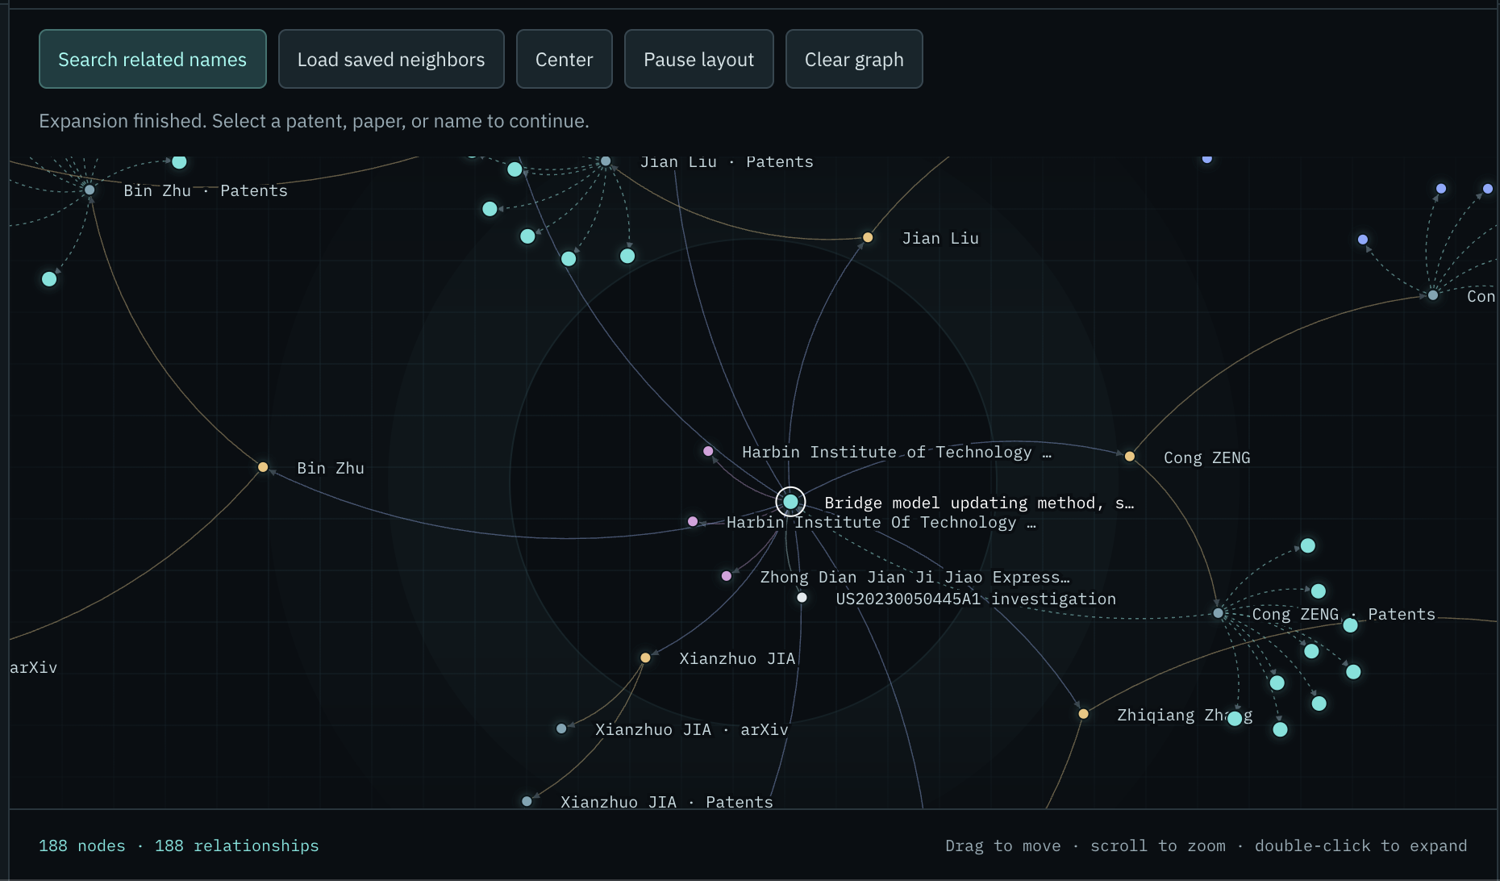








SYS.OP // KNOWLEDGE GRAPH ENGINE // LN-447
Knowledge Graphs Transform Unstructured Data into High-Fidelity Network Maps
[ARXIV & PATENT RESOLUTION]
The system automatically reconciles and extracts fragmented author and inventor identities directly from arXiv preprints and Google Patents database records to build verified technical profiles.
LIVE GRAPH: ARXIV_PATENT_TRK
[RESEARCHER_MATCH]
[PATENT_DISCLOSURE]
[ARXIV & PATENT ANALYSIS]
Unstructured academic preprints and patent publications are converted into an explorable network, mapping citation lines and shared disclosures between researchers and corporate entities.
[CENTRAL DEV NODE]
[CROSS-CITATION CORRELATION]
Graph algorithms track co-citations and joint developments across arXiv preprints and Google Patents filings, identifying foundational intellectual IP chokepoints.
[ARXIV_PREPRINT]
[GOOGLE_PATENTS]
ALGORITHM: PAGE_RANK
ITERATIONS: 1,024
VERIFIED PROFILE
CRITICAL CHOKEPOINT
STATUS: SECURE // LINK: STABLE // RENDER: PROGRESSIVE DISCOVERY MODE ACTIVE // CLASSIFICATION: TOP SECRET

Slide 5
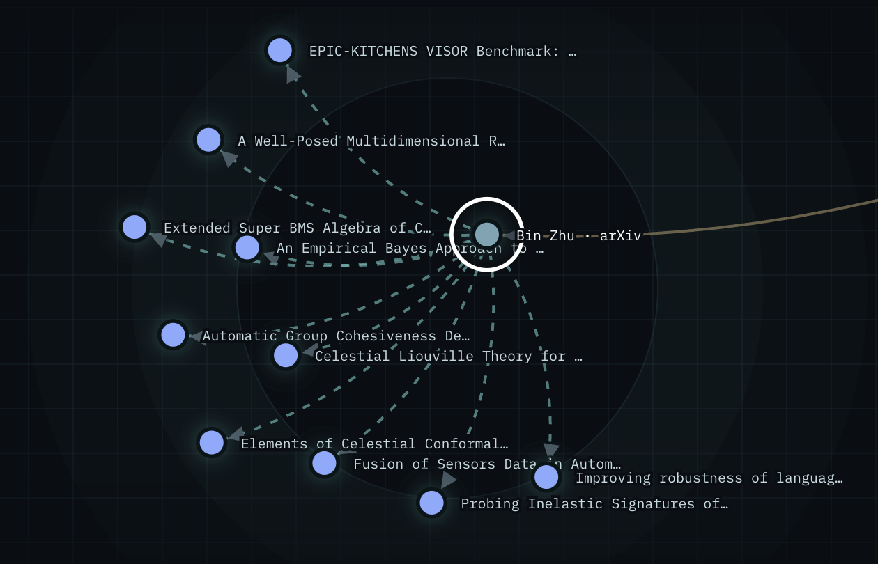





SYS.OP // NODE-LINK ACTIVE // TRK-99
PRECISION INTELLIGENCE ENABLES TARGETED INTERVENTIONS TO DISRUPT HYPERSONIC DEVELOPMENT
COGNITIVE GRAPH ENGINE // ADVERSARY PIPELINE RESOLUTION
[ STATUS: ACTIVE ]
[01] ECONOMIC SANCTIONS
Identifies specific front companies and financial networks for precision economic targeting and treasury sanctions.
FIN. NETWORKS
MFG. CHOKE
[ RISK: SEVERE ]
[02] EXPORT CONTROLS
Informs the restriction of bespoke manufacturing equipment and specialized raw materials, degrading the adversary's production capacity.
FRONT CO.
KEY RESEARCH
[ CRITICAL CHOKEPOINT IDENTIFICATION ]
STRATEGIC CHOKEPOINTS
The intelligence graph provides INDOPACOM and Strategic Command with exact vulnerabilities within the adversary's scaling pipeline.
[ VECTOR: DISRUPT ]
[03] INFLUENCE OPERATIONS
Maps key personnel and research institutions to support targeted disruption and counter-intelligence operations.

Slide 6
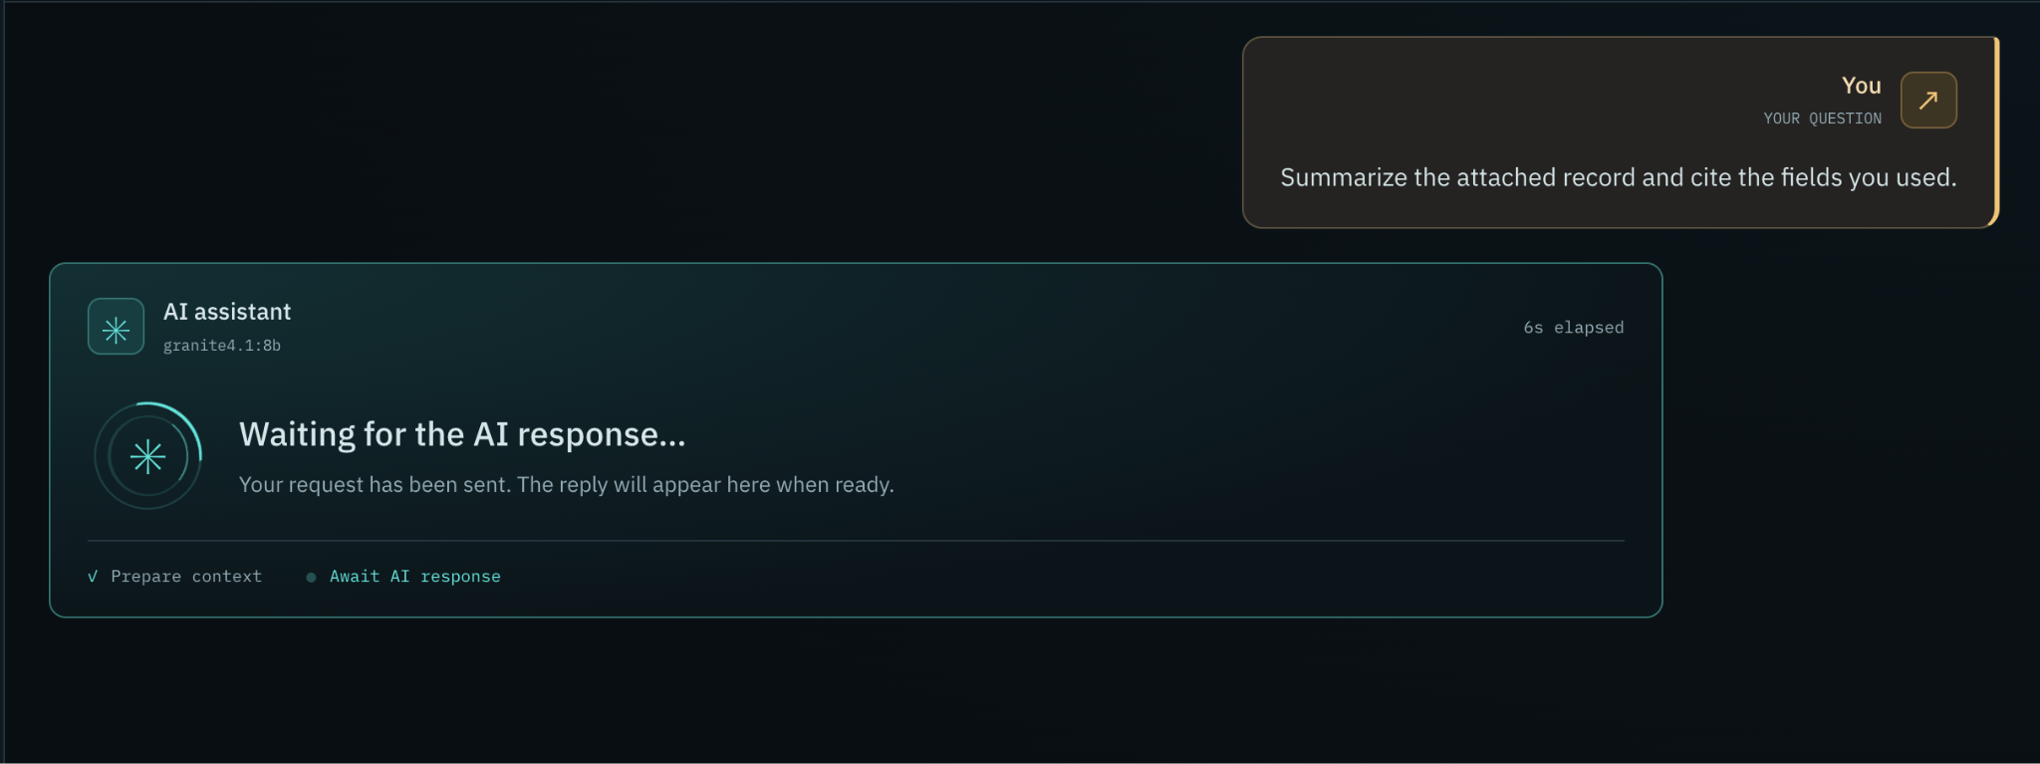
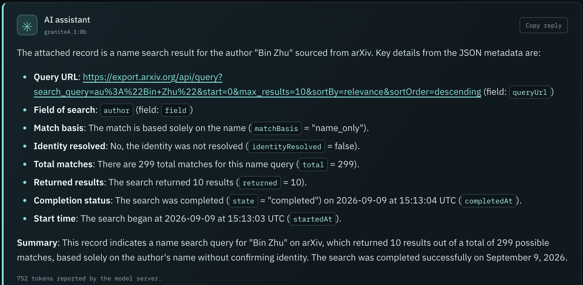
SYS.OP // NODE-LINK ACTIVE // TRK-99 // USER: J. GREGORY
MISSION-CONTROL INTERFACE ACCELERATES COMPLEX INTELLIGENCE ANALYSIS
[ QUERY: LOCAL AI PIPELINE / FOREIGN TRANSLATION / KEYWORDS ]
[ LOCAL AI PLATFORM ]
A fully offline, air-gapped language model architecture designed to process sensitive intelligence locally without external API calls, maintaining complete operational security.
ACTIVE INTERACTIVE NODE-LINK GRAPH
AI COGNITIVE EXTRACTION PANEL
[ PDF SUMMARIZATION ]
Generates multi-level, structured summaries of complex technical documents, extracting core scientific methodologies and testing parameters instantly.
[ KEYWORD ANALYSIS ]
Sifts through translated corpora to isolate strategic keywords, military-industrial codes, and institutional names to map underlying development networks.
[ FOREIGN TRANSLATION ]
Automated neural translation engines convert raw foreign aerospace preprints, patents, and military research papers into English while preserving complex technical nomenclature.
STATUS: SECURE // LINK: STABLE // RENDER: PROGRESSIVE DISCOVERY MODE ACTIVE // CLASSIFICATION: TOP SECRET

Slide 7
SYS.OP // PROJECT TURNCOAT // DOWN-SELECT STRATEGY // TRK-100
DOWN-SELECT ROADMAP: ADVANCED COGNITIVE ANALYTICS & SUPPLY CHAIN PREDICTION
[ PHASE I: ANALYTICS, TAGGING & COGNITIVE INFERENCE ]
Improved Analytics & Tagging
Integration of automated NLP taxonomy generators to auto-tag raw research with military codes and standardized aerospace nomenclature.
Enhanced AI Inference
Transitioning models to a multi-agent routing pipeline, dramatically increasing local extraction speed and technical keyword classification accuracy.
COUNTERMEASURE RECOMMENDATION ENGINE
[ FUTURE TARGETS ]
[01] TECHNOLOGICAL DEGRADATION
Recommends precision exports control protocols targeting advanced carbon-carbon composites and bespoke sintering furnaces identified in patent data.
[02] ECONOMIC INTERVENTION
Tracks funding paths of front companies using localized co-citation anomalies to recommend structured banking blockades and financial penalties.
[ PHASE II: END-TO-END SUPPLY CHAIN PREDICTION ]
Full Supply Chain Mapping
Scaling node-link graph capabilities from isolated researchers to map the entire industrial base—correlating precursors, tooling, and end-stage delivery.
Chokepoint Discovery
Identifying critical structural dependencies where single-source manufacturers or specialized alloys threaten adversary scaling efforts.
[03] OPEN DATA DISSEMINATION
Provides structured, classified graph exports to unified combatant commands, enabling external agencies to model independent kinetic/cyber options.
STATUS: SECURITY AUDITED // LINK: ENCRYPTED // MISSION STACK: DOWN-SELECT PROPOSAL READY // CLASSIFICATION: SECRET

